Slide 1
The Analytics Team
Sprocket Central Pty Ltd
Data Analysis Approach

Slide 2
Agenda
Introduction
Data Exploration
Model Development
Interpretation

Slide 3
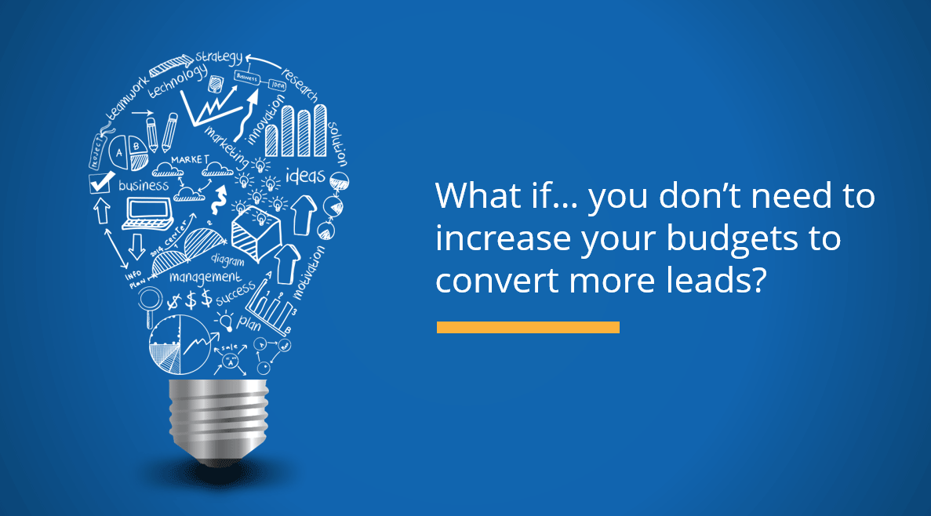
Introduction
Data Analysis approach is one of the major task that a analytics team should perform to in order to provide effective insights and results to the clients.

Slide 4
Data Exploration
In the data exploration process, we try to Understand the characteristics of given fields in the underlying data such as variable distributions, whether the dataset is skewed towards a certain demographic and the data validity of the fields. For example, a training dataset may be highly skewed towards the younger age bracket. If so, how will this impact your results when using it to predict over the remaining customer base.

Slide 5
Recommendation for the above point:
We can use Normalization techniques such as logarithmic distribution, Exponential distribution, Box-Cox distribution to remove the skewedness and make the data normally distributed.
2. There are some limitations in the given datasets like some values are missing and some data types are different according to their value.
Recommendation for the above point:
This kind of can be handled in the feature engineering section where we try to handle the missing values by replacing it mean, median or mode.

Slide 6
3. Furthermore, transformation of required data so that it is in an appropriate format for analysis. This may include steps such as ensuring that the data types are appropriate and rolling data up to an aggregated level. Or, joining in already aggregated ABS data at a geographic level to create additional variables. 4. Document assumptions, limitations and exclusions for the data; as well as how you would further improve in the next stage if there was additional time to address assumptions and remove limitations.

Slide 7
Model Development
First of all, we have to determine a hypothesis related to the business question that can be answered with the help of existing data. Perform statistical testing to determine if the hypothesis is valid or not.
Create calculated fields based on existing data, for example, convert the D.O.B into an age bracket.
For suitable models we have to consider the model performance, assumptions and limitations. For Example if we consider some of the Machine learning algorithms each of the algorithms have there specific model performance, assumptions etc.

Slide 8
Linear Regression: The most popular performance measures are R squared and the root mean squared error (RMSE).
Logistics Regression: The performance measures for logistics regression are confusion Matrix, AIC, ROC curves.
Test the performance of the model using factors like residual deviance, AIC, ROC curves, R Squared). Appropriately according to the model performance, assumptions and limitations.

Slide 9
Interpretation
After the model development we try to interpret the data in which we provide effective business insights and reports. This may involve interpreting the significant variables and co-efficient from a business perspective.
Based on the model, the results and insights are performed using some of the BI(Business Intelligence) tools such as Tableau, Power BI etc which would help us to provide the reports in the form of dashboards.
Also, this BI tools make the analysts to predict the future more accurately and these tools are widely used for Decision making processes in the industry.

